Slide 1
Assessing Time Series Databases in DevOps with OptimaTech

Slide 2
Agenda
Current System Analysis
Amazon Timestream Overview
Critical Analysis of Timestream in DevOps
Timestream Implementation
DevOps Queries

Slide 3
Current System Analysis

Slide 4
OptimaTech – The Only Optimal Tech Decision
OptimaTech is a cloud-based technology solution company that is rapidly growing and supporting a wide variety of industries.
OptimaTech is currently having internal performance issues with its DevOps monitoring as the large scale of time series data is putting strain on the existing database.
Problem Statement
Implement a Time-Series Database to effectively monitor the DevOps infrastructure for OptimaTech.
Notes:
This slide goes over the problem statement of the given scenario for the assignment.

Slide 5
OptimaTech – Issues With Data Volume
DevOps Monitoring – The process of analyzing and monitoring network infrastructure and performance based on key performance indicators (KPIs) that are set by IT.
Because OptimaTech is rapidly growing, they are supporting more and more infrastructure for many different applications.
Monitoring this infrastructure to ensure high availability and performance for their users is causing a large volume of time series data to be generated.
The volume of this data causes problems on traditional databases that do not have high write throughput.
(LinkedIn, 2025)
Notes:
This slide goes over the company's issues data volumes of their devops architecture.

Slide 6
OptimaTech – Issues with Real-Time Analysis
Because of the industries that OptimaTech supports with their cloud platform, such as monitoring climate and traffic patterns, high availability and performance are critical aspects.
OptimaTech needs to be able to see these variables in real-time to ensure that they are operating at the levels they need to.
Their current setup struggles with real-time reporting because traditional databases store data on the disk, which causes latency in data retrieval.
There are also complex queries required to access the data that is needed for the analysis needed, causing additional latency as the queries need to search entire DBs for the data requested at times.
Notes:
This slide goes over the company's issues with real time analysis of their devops architecture.

Slide 7
OptimaTech – Issues with Decision Making
Because of the current setup, OptimaTech also has struggles with decision making.
Relational databases are not designed specifically for time-series data, so additional data processing is required to get the data in a state that can be analyzed for effective decision making.
These extra processing steps can lead to errors and inaccurate analysis.
This makes things like anomaly detection and highlighting where performance issues started difficult, which are two critical variables in DevOps decisions.
Notes:
This slide goes over the company's issues with decision making regarding their DevOps architecture because they do not have easy ways to see their data.

Slide 8
Amazon Timestream Overview

Slide 9
Time Series Databases
Time-Series data is data where Time is a primary measurement.
01
An example of this would be sensor data collected in 5 min intervals.
This data can be collected in regular or irregular intervals.
Time-Series Databases (TSDBs) are DBs that are designed and optimized for time-series data.
02
TSDBs excel and have architecture to support querying data over long time periods unlike traditional DBs.
03
TSDBs have data expiration methods built in, to ensure that you don’t have database bloat as collect more and more data points.
04
(Time Series Database (TSDB) Guide | InfluxDB, n.d.)
(Influxdata, 2022)
Notes:
This slide provides a high level overview of time series databases.

Slide 10
Amazon Timestream - Overview
Fully managed database engine for time-series data on AWS.
Provides scalability benefits being under the AWS umbrella.
No need to worry about underlying architecture for deployment.
Utilizes all the security features that AWS has to offer.
Built on top of widely used open sourced DBs such as InfluxDB and Telegraf.
Notes:
This slide goes over a high-level overview of AWS Timestream.

Slide 11

Amazon Timestream - Architecture
Timestream takes in time series data from a source and stores it in one of two locations called storage tiers.
In-Memory tier – handles the processing of the data into the database and allows for keeping the data here for a set period. It is optimized to have minimal latency for real-time analytics.
Magnetic tier – was designed to support analytical queries and is low-cost long-term storage of data.
Timestream also has a dedicated query layer for easy querying of data using a language that is very similar to SQL.
Timestream stores data in tables, but you do not need to specify the columns upon table creation like you would in a traditional database.
These “columns” are called dimensions, and each table can support 128 unique values.
The data type for all these dimensions is varchar.
(Architecture - Amazon Timestream, 2025)
Notes:
This slide dives more into the architecture of AWS Timestream.

Slide 12
Timestream vs Traditional DBs
Comparison for Time-Series Data Use Case | Timestream | Traditional Relational DB
Scalability | Hosted on AWS, can scale horizontally as needed as more data gets collected and ingested. | Scales vertically by adding additional hardware, which can be costly. Requires additional software and architecture to scale horizontally using partitions.
Storage | Has two dedicated memory layers, so data can be stored in memory for lower latency and quicker query access for real time analytics. | Stores everything in magnetic disk storage, which has high latency due to the I/O requirements for data retrieval from the disk.
Data Ingestion | Timestream has specific architecture and design to support large scale data ingestions at a time. | Can struggle with applications that require low latency and high write throughput, such as DevOps and IoT.
Retention | Has built in capability to set time to live (TTL) polices for data in memory and in magnetic storage. | Needs additional setup to properly implement retention polices for the data.
(Compare Amazon Timestream for LiveAnalytics vs SQL Server, 2017)
Notes:
This slide compares Timestream to traditional DBs.

Slide 13
Critical Analysis of Timestream in DevOps

Slide 14
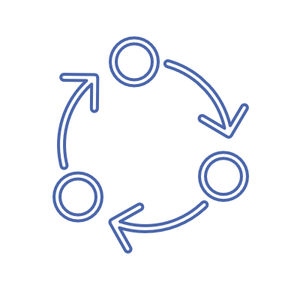
DevOps Monitoring – Just in Time
DevOps Monitoring – The process of analyzing and monitoring network infrastructure and performance based on key performance indicators (KPIs) that are set by IT.
Performance Monitoring – process of monitoring the health of IT infrastructure in real-time. This would be things like CPU usage, latency, etc.
Anomaly Detection – process of looking at and finding unusual patterns, such as spikes in network traffic for an application or latency.
Capacity Planning – process of looking at historical data to drive and make business decisions on the allocation of infrastructure and resources.
There are a few main goals of DevOps monitoring which are anomaly detection, performance monitoring, and capacity planning.
(Fayard, 2025)
Notes:
This slide goes over DevOps monitoring in more detail.

Slide 15
Timestream and DevOps – Data Volume and Scaling
Timestream can help with the large volumes of data that is generated from monitoring network infrastructure for OptimaTech.
Timestream can scale horizontally to add additional infrastructure as needed to reduce overall database load on a single partition. It does this automatically based on demand.
Timestream also has a high write throughput to be able to handle the volume of data points that are coming in from the various infrastructure that is being monitored.
Again, additional resources are automatically added to ensure that there is not latency in writing data into the database.
Notes:
This slide goes over how Timestream can help in DevOps.

Slide 16

Timestream and DevOps - Performance
Timestream offers better performance than traditional relational databases in DevOps monitoring.
Real-time analysis is important for performance monitoring and anomaly detection.
Timestream has a dedicated in memory storage layer, which allows for low latency access to certain data for real-time monitoring.
Timestream also has built in data compression based on time periods, making searching through the data easier and more logical.
Timestream also has a dedicated query layer to ensure low latency when retrieving the data for real-time analysis.
(Popat, 2024)
Notes:
This slide goes over how Timestream can help in DevOps.

Slide 17
Timestream and DevOps – Cost Effectiveness
Time Series applications can be expensive due to the large volumes of data generated. DevOps monitoring generates a lot of data quickly for each piece of critical architecture that is being monitored.
Storage costs are reduced with the built-in data compression that Timestream offers.
They are reduced further by setting data expiration limits for data stored in memory.
This data gets then stored in magnetic disk storage, which is cheaper and accessed less.
Timestream also benefits from being under the AWS umbrella, so it has a pay as you go model which also brings down costs.
Timestream can be cost effective if implemented and utilized in the proper way.
This storage option allows for cheap and easy access to historical data which can then be used for capacity planning.
(Popat, 2024)
Notes:
This slide goes over how Timestream can help in DevOps.

Slide 18
Timestream and DevOps - Limitations
Timestream does have some limitations, however.
If your architecture that you are monitoring does not reside in AWS, then there is additional complexity in setup and integrating Timestream to your network.
Timestream tables are append only also, so there is no ability to go back and modify data.
This means that defining your dimensions is critical to success.
Timestream does not support cross-table joins either, so if you want to run analytics you need make sure the all the information resides in the same table.
(Aggarwal, 2022)
Notes:
This slide goes over how Timestream’s limitations.

Slide 19
Timestream Implementation

Slide 20
Integrating with OptimaTech
Going back to the problem statement
Implement a Time-Series Database to effectively monitor the DevOps infrastructure for OptimaTech.
Step 1: Determine the data that needs to be collected
Key performance indicators from each piece of architecture that needs to be monitored.
Uptime – How often is a device sending and receiving data.
CPU Utilization – What percent of computer resources are being used on a device.
Throughput – Amount of traffic passing through a device.
Bandwith Usage - Amount of data that is being sent and received by a device.
(Datadog, 2021)
(Data Modeling Best Practices to Unlock the Value of Your Time-Series Data | AWS Database Blog, 2023)
Notes:
This slide goes over the first steps to create a data model for Timestream.

Slide 21
Integrating with OptimaTech
Step 2: Choosing the right dimensions and measures from the existing database
Need to ensure that the dimensions make sense and that they are consistent across the applications OptimaTech has deployed.
Choosing the right dimensions will make querying and filtering easier and faster for analysis.
Application_ID – specify which application the architecture is being used on.
Application_Name – easier when pulling data for analytics for efficient queries and visualization.
Time_Stamp – Need to pull a timestamp for time series data to be effective.
CPU_Usage – This will determine the load on the application and could even trigger scaling policies if needed.
HTTP_Status – Pulling this code will let you know if the application is running or not (Uptime).
Network_Throughput – Value to let you know how much traffic is passing through an application.
Memory_Usage – Percent of memory used in an application.
(Data Modeling Best Practices to Unlock the Value of Your Time-Series Data | AWS Database Blog, 2023)
Notes:
This slide goes over the second step to create a data model for Timestream.

Slide 22
Integrating with OptimaTech
Step 3: Choosing a partition key
Step 4: Determine the data retention polices for storing data in memory for real-time analysis/ anomaly detection
For monitoring network health, I think it makes sense to keep data in memory for low latency access for 8 hours at a time.
For OptimaTech the partition key should be Application_Name so the data can be efficiently searched and visualized based on each IoT application that OptimaTech has deployed.
After, it can then be sent to the more permanent magnetic storage for historical analysis.
(Data Modeling Best Practices to Unlock the Value of Your Time-Series Data | AWS Database Blog, 2023)
Notes:
This slide goes over the third and forth step to create a data model for Timestream.

Slide 23
Creating the Timestream DB
Log into the AWS management console by creating an account.
Under services, navigate to Security, Identity, and Compliance and select IAM.
Once there, select users and create user.
Name the user and hit next until you create the user.
Once created select the user, go to the security credentials tab and select create access key.
Select the option for local code use.
Hit create and download the .csv file for safe keeping.
Notes:
This slide goes over creating IAM User profiles to be able to interact with AWS locally.

Slide 24
Local Timestream Access
Next on your local machine open your python environment to install Boto3 by using python –m pip install boto3.
Boto3 – Python API to perform CRUD operations in Timestream locally.
Then we want to download and install the AWS command line interface (CLI) to modify our AWS configuration files easily.
Once it has been downloaded and installed, open a CMD and type aws configure.
It will prompt you to enter you access key, secret key, default region, and output format.
Enter in these values and you should be setup properly.
Notes:
This slide goes over local installation and what is needed to push local code to Timestream.

Slide 25
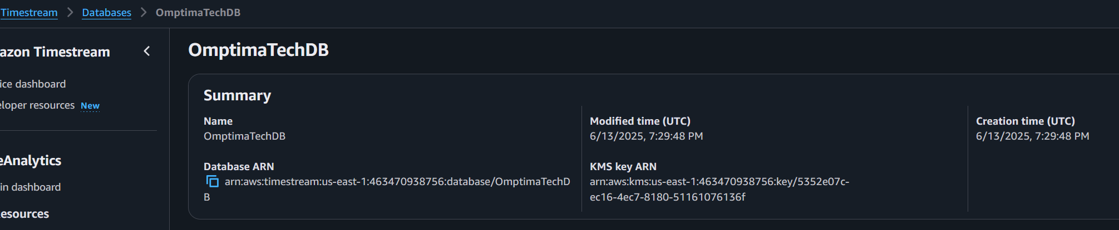
Creating the Timestream DB
The following code in your local instance will allow for database creation once you have successfully connected to AWS using your user access key:
import boto3
timestream = boto3.client('timestream-write')
database_name = 'OmptimaTechDB'
try:
response = timestream.create_database(DatabaseName=database_name)
print(f"Database '{database_name}' created successfully.")
except timestream.exceptions.ConflictException:
print(f"Database '{database_name}' already exists.")
except Exception as e:
print(f"Error creating database: {e}")
Notes:
This slide goes over the python code to creating a DB in Timestream.

Slide 26
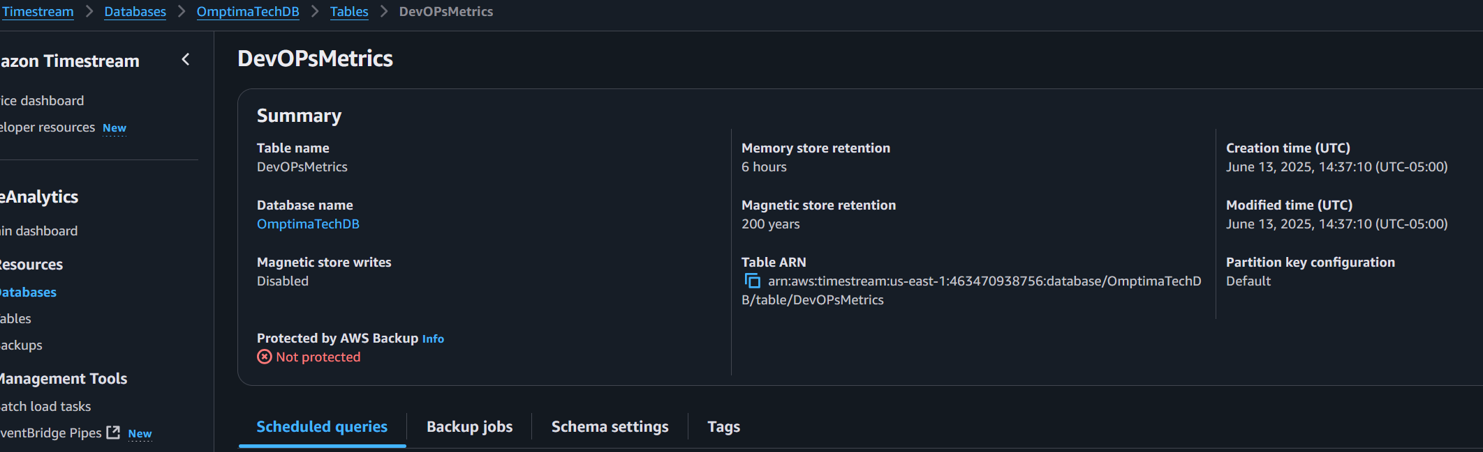
Creating the Table
The following code will create a table for data to be entered in the Timestream database:
import boto3
timestream = boto3.client('timestream-write')
database_name = 'OmptimaTechDB'
table_name = 'DevOPsMetrics'
try:
response = timestream.create_table(
DatabaseName=database_name,
TableName=table_name
)
print(f"Table '{table_name}' created successfully in database '{database_name}'.")
except timestream.exceptions.ConflictException:
print(f"Table '{table_name}' already exists in database '{database_name}'.")
except Exception as e:
print(f"Error creating table: {e}")
Notes:
This slide goes over the python code to creating a table inside a DB in Timestream.

Slide 27


Sample Data for Test Queries
The following code was used in python to upload a test data set I created in a csv file to test writing data into Timestream.
Note that if my timestamps were not within the in-memory store retention limits, this data would be rejected if I had not enabled magnetic storage writes in Timestream.
with open(csv_file_path, 'r', encoding='utf-8-sig', newline='') as csvfile:
reader = csv.DictReader(csvfile)
print("CSV Headers:", reader.fieldnames)
for row in reader:
dimensions = [
{'Name': 'Application_ID', 'Value': row['Application_ID']},
{'Name': 'Application_Name', 'Value': row['Application_Name']}
]
metrics = ['CPU_Usage', 'HTTP_Status', 'Network_Throughput', 'Memory_Usage']
records = []
for metric in metrics:
value_type = 'DOUBLE' if metric != 'HTTP_Status' else 'BIGINT'
records.append({
'Dimensions': dimensions,
'MeasureName': metric,
'MeasureValue': row[metric],
'MeasureValueType': value_type,
'Time': parse_timestamp(row['Time_Stamp']),
'TimeUnit': 'MILLISECONDS'
})
try:
timestream.write_records(
DatabaseName=database_name,
TableName=table_name,
Records=records
)
print(f"Uploaded metrics for {row['Application_ID']} at {row['Time_Stamp']}")
except Exception as e:
print(f"Error uploading record: {e}")
print(e.response)
time.sleep(1)
Notes:
This slide goes over adding data to Timestream using a .csv file and python.

Slide 28
DevOps Queries

Slide 29
Querying with AWS CLI
Using the AWS CLI is an easy way to query data from Timestream.
In practice however, queries will probably be run by Lambda to display to some kind of visualization tool for real-time monitoring.
You can also use boto3 and python to query Timestream if you would like.
You can create queries that filter by time, metrics, perform aggregations, and combine them together to provide powerful insights!
Notes:
This slide talks about Queries in Timestream and some of the things that can be done with them.

Slide 30
Query by Application_Name
aws timestream-query query --query-string 'SELECT * FROM "OmptimaTechDB"."DevOPsMetrics" WHERE Application_Name = ''TrafficManagementSystem'' ORDER BY time DESC LIMIT 100’
This query selects the DB and table and returns the 100 newest data points where the metric Application_Name is TrafficManagementSystem.
aws timestream-query query --query-string 'SELECT Application_Name, time, measure_value::double FROM "OmptimaTechDB"."DevOPsMetrics" WHERE measure_name = ''CPU_Usage'' ORDER BY Application_Name, time’
This query selects the DB and table and returns the measure CPU_Usage and groups the value by the Application Name.
Notes:
This slide goes over queries by Application_Name as a practical example of what OptimaTech would use.

Slide 31
Query by Time
aws timestream-query query --query-string 'SELECT * FROM "OmptimaTechDB"."DevOPsMetrics" WHERE time < ago(1h)’
This query grabs every data point from the table that is less than 1 hour old. Great for looking for anomalies in the network.
aws timestream-query query --query-string 'SELECT * FROM "OmptimaTechDB"."DevOPsMetrics" WHERE time BETWEEN ago(10m) AND ago(5m)’
This query grabs every data point from the table that is between 5 and 10 minutes old. Great for taking a closer look a specified chunk of time.
Notes:
This slide goes over queries by time filters as a practical example of what OptimaTech would use.

Slide 32
Bibliography
Amazon Web Services. (2020, September 30). Getting Started with Amazon Timestream. YouTube. https://www.youtube.com/watch?v=8RHFPNReylI
Architecture - Amazon Timestream. (2025). Amazon.com. https://docs.aws.amazon.com/timestream/latest/developerguide/architecture.html
Adamson, C. (2024, February 29). Introduction to Amazon Timestream for Time Series Data. Medium. https://medium.com/@christopheradamson253/introduction-to-amazon-timestream-for-time-series-data-a781ee0428c5
Influxdata. (2022). What is time series data? | Definition and Discussion. InfluxData. https://www.influxdata.com/what-is-time-series-data/
Time Series Database (TSDB) Guide | InfluxDB. (n.d.). InfluxData. https://www.influxdata.com/time-series-database/

Slide 33
Bibliography
LinkedIn. (2025). Linkedin.com. https://www.linkedin.com/pulse/importance-timeseries-database-devops-mthokozisi-sithole/
Fayard, M. (2025, January 9). Time Series Database (TSDB): A Guide With Examples. Datacamp.com; DataCamp. https://www.datacamp.com/blog/time-series-database
How DevOps Monitoring Works: Concepts, Types & Best Practices. (n.d.). Splunk-Blogs. https://www.splunk.com/en_us/blog/learn/devops-monitoring.html
Popat, M. (2024, November). Harnessing Real-Time Insights with AWS Timestream: The Ultimate Guide to Time-Series Data. Medium. https://mihirpopat.medium.com/harnessing-real-time-insights-with-aws-timestream-the-ultimate-guide-to-time-series-data-873f7b853b89
Aggarwal, K. (2022, September 20). Amazon Timestream: Overview, Limitations, Pricing & Many More. https://k21academy.com/amazon-web-services/amazon-timestream/

Slide 34
Bibliography
GeeksforGeeks. (2020, June 12). Architecture of Internet of Things (IoT). GeeksforGeeks. https://www.geeksforgeeks.org/computer-networks/architecture-of-internet-of-things-iot/
Datadog. (2021, October 18). Network Monitoring: What It Is & How It Works | Datadog. Network Monitoring: What It Is & How It Works. https://www.datadoghq.com/knowledge-center/network-monitoring/
Data Modeling Best Practices to Unlock the Value of your Time-series Data | AWS Database Blog. (2023, September 14). Aws.amazon.com. https://aws.amazon.com/blogs/database/data-modeling-best-practices-to-unlock-the-value-of-your-time-series-data/
Compare Amazon Timestream for LiveAnalytics vs SQL Server. (2017). Influxdata.com. https://www.influxdata.com/comparison/awstimestream-vs-sqlserver/

